Slide 1


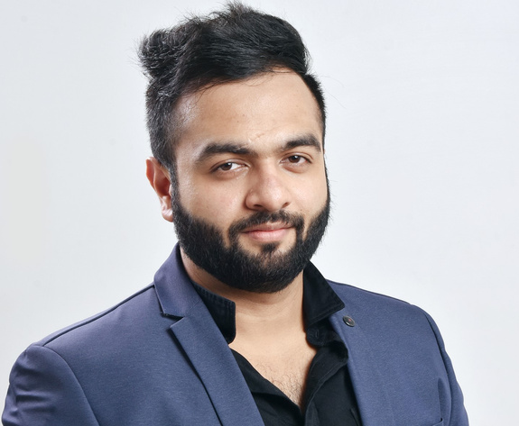

About Me
Anupam Singh
I am an aspiring data analyst harboring a proclivity towards engaging with my connections on LinkedIn through Data related content.

Slide 2

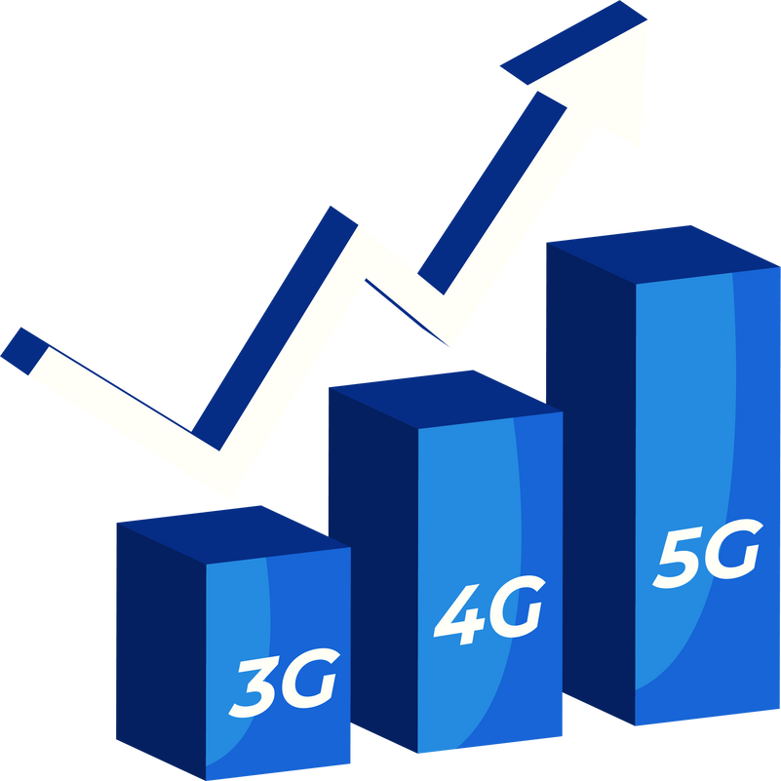
WAVECON
TELECOM ANALYSIS
Task 4 Presentation
At AtliQ Technologies
Presented by: Anupam Singh

Slide 3

Introduction about the company
Problem Statement
AGENDA
Objective
About Data
Inisghts & Recommendations

Slide 4







ABOUT THE COMPANY
WaveCon Telecom, a prominent leader in the telecommunications industry, has recently achieved a significant milestone with the launch of its 5G network service.
This advancement marks a transformative step in the company's mission to revolutionize connectivity

Slide 5



PROBLEM STATEMENT
The company is navigating numerous challenges in the rapidly evolving telecom landscape, particularly following the introduction of 5G in May 2022.

Slide 6

GOAL
Communication
Effectively convey the insights.
Decision Making
Equip stakeholders with a comprehensive understanding to enable informed, data-driven decision-making.

Slide 7




DATA OVERVIEW
WaveCon has established a strong presence across 15 cities.
The analysis is based on data consolidated over an 8-month timeline.
Jan
to
Apr
Jun
to
Sept
May
Before 5G
5G Rolled- Out
After 5G

Slide 8



IMPACT ON REVENUE POST 5G LAUNCH
What is the impact of the 5G launch on revenue?

Slide 9
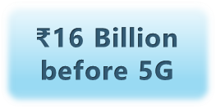
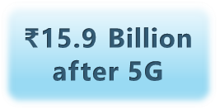
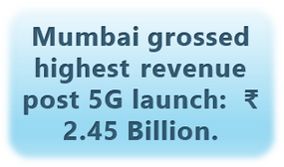
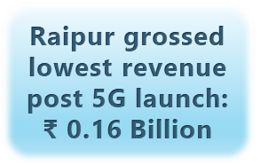


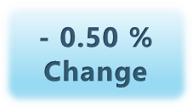
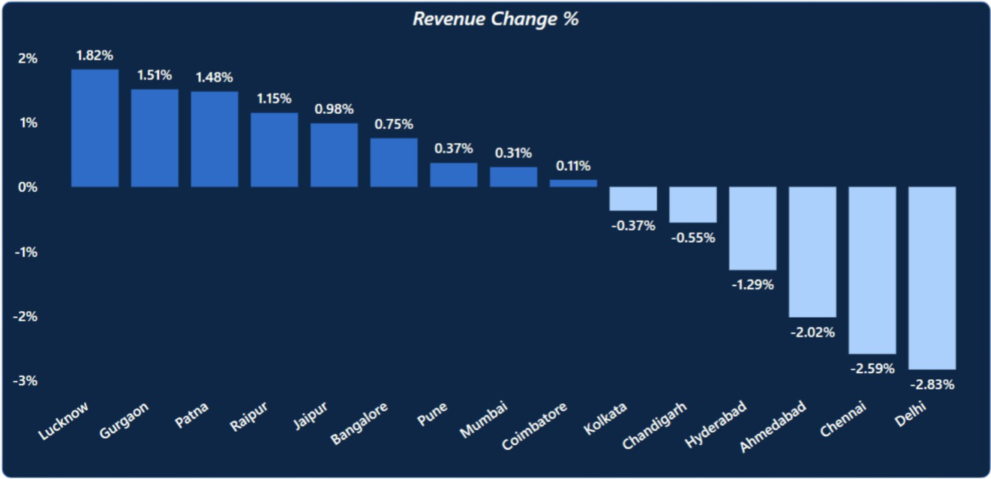

Slide 10


UNDERPERFORMING KPI ANALYSIS
Which KPI is underperforming after the 5G launch?

Slide 11
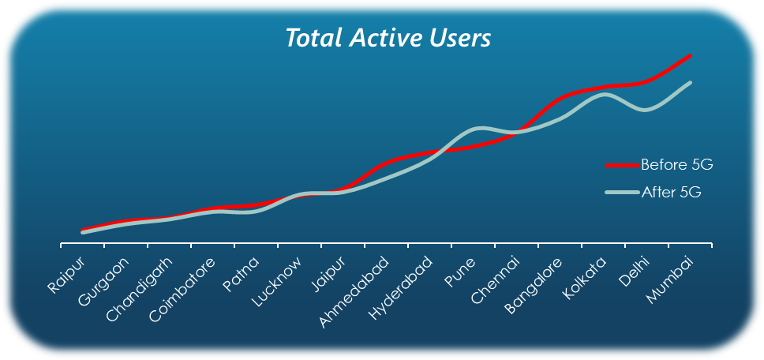
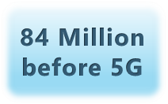
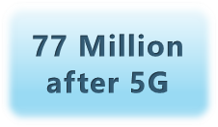




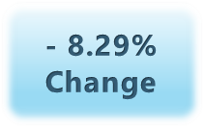


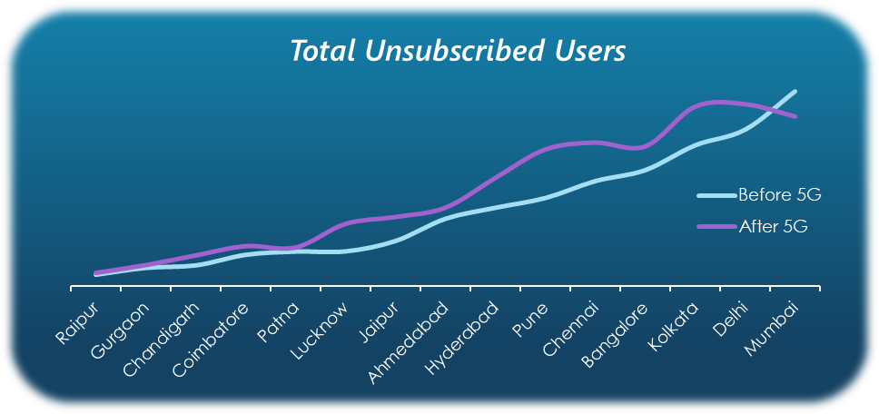
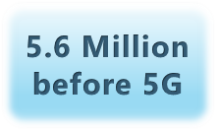
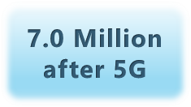




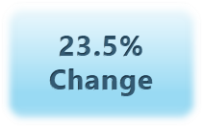



Slide 12


TARIFF/PLAN ANALYSIS
After the 5G launch, which plans are performing well in terms of revenue? Which plans are not performing well?

Slide 13
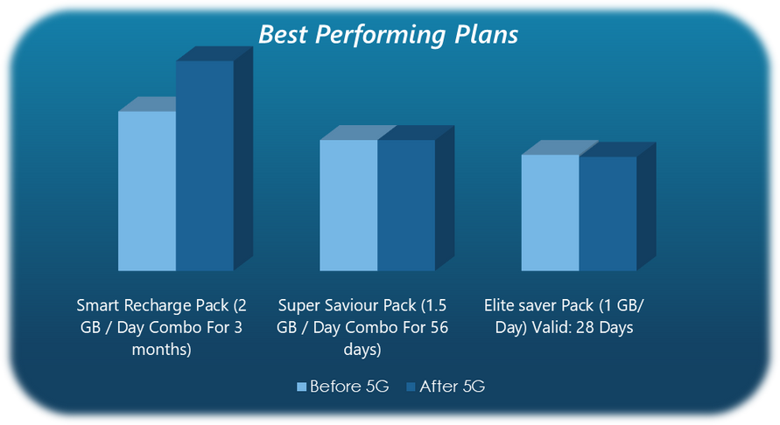
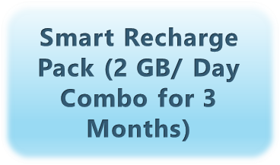
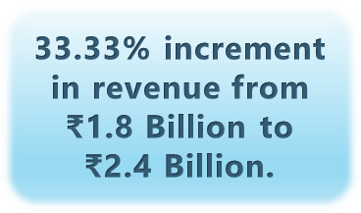
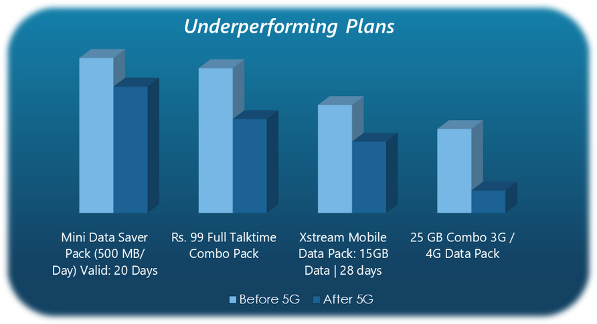
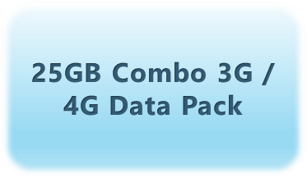
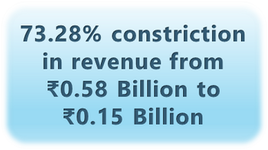
Best Performing Plan:
Most Underperforming Plan:

Slide 14


5G LAUNCH IMPACT: STRATEGIC PLAN DECISIONS
Is there any plan affected largely by the 5G launch? Should we continue or discontinue that plan?

Slide 15



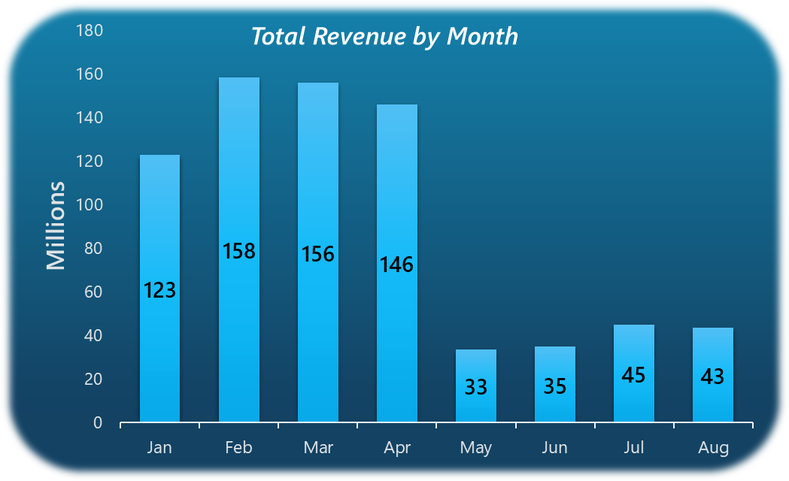



Plan Most Impacted by the 5G Roll-Out:
Revenue trends before
5G Launch
Revenue trends after
5G Launch

Slide 16


DISCONTINUED PLAN IDENTIFICATION
Is there any plan that is discontinued after the 5G launch? What is the reason for it?

Slide 17

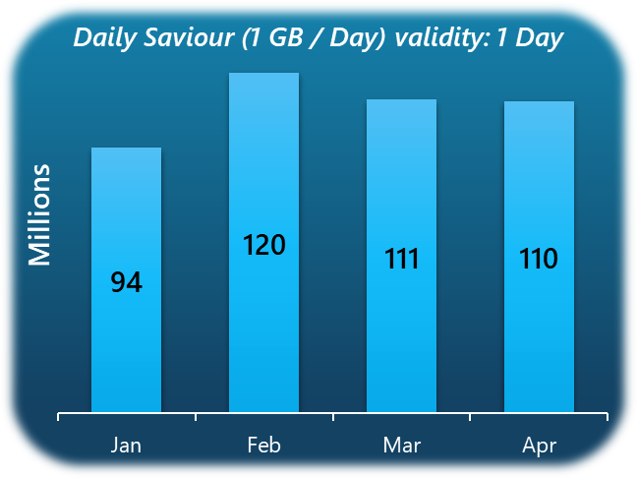
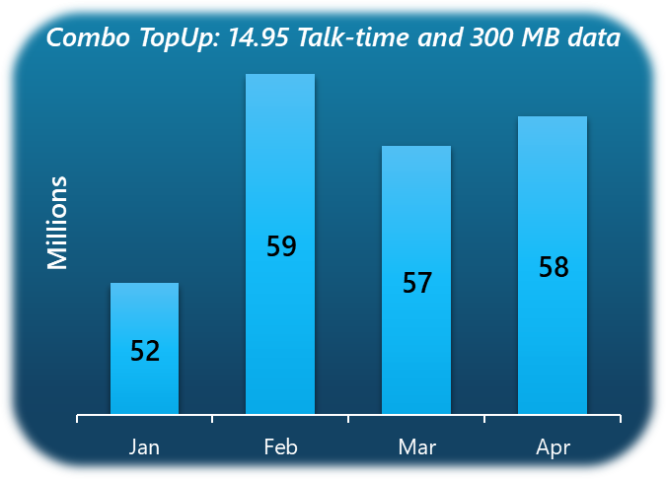
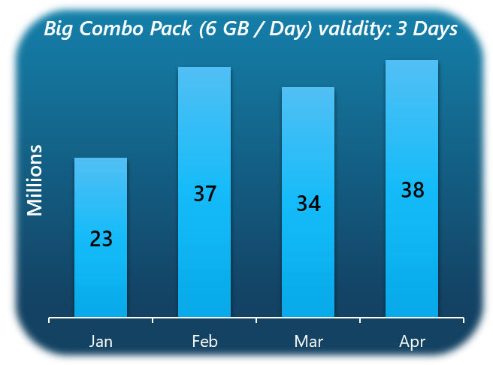





Possible reasons for discontinuation of these plans:

Slide 18

RECOMMENDATIONS

Slide 19






Expand Market Reach
Enhance Customer Experience
Diversify Product Portfolio
Marketing and Branding
Anticipate Market Trends

Slide 20


Thank You For Watching
For any queries or recommendations,
anupam848484@gmail.com

